Slide 1
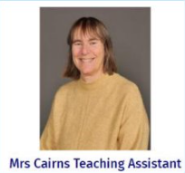
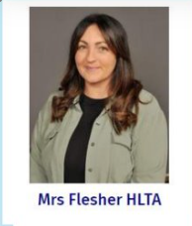
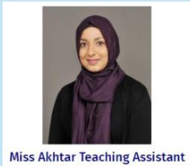
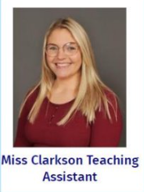
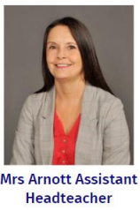
Welcome to Year 6!

Slide 2
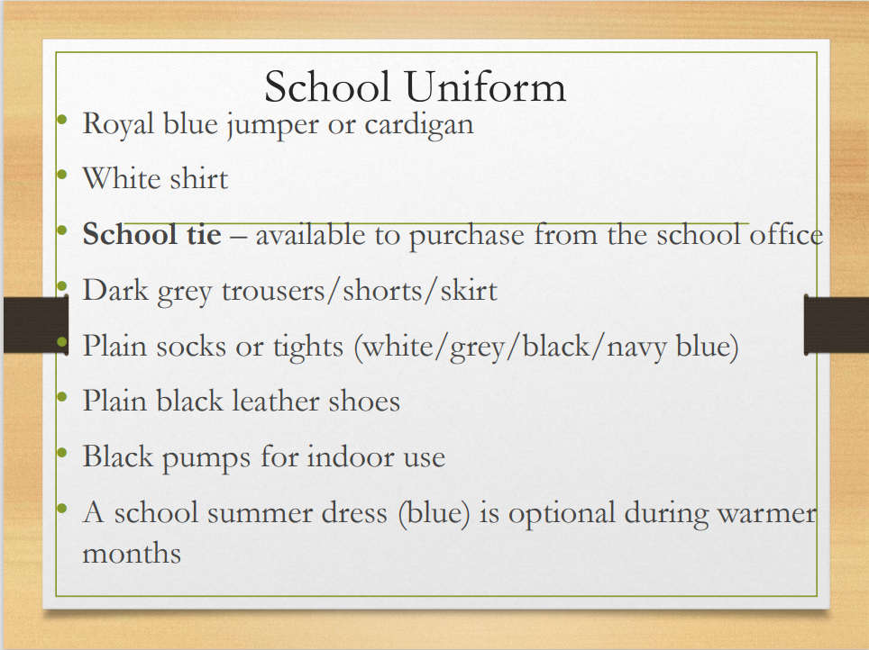

Slide 3
Hair should be tied back, and hair accessories should be plain (blue, black, white)
Jewellery should not be worn apart from religious jewellery and a plain watch.
Stud plain earrings are acceptable.
No nail varnish should be worn.
All children must bring water bottle to school.

Slide 4
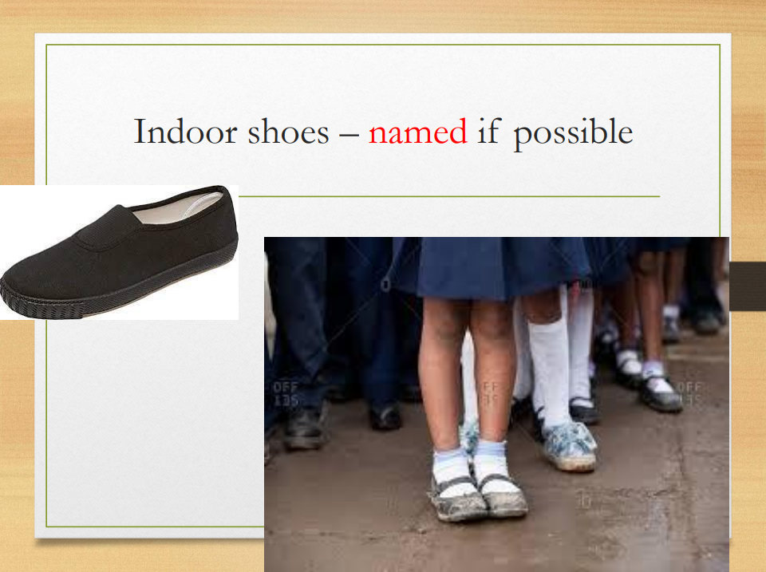

Slide 5
PE: Thursday and Friday afternoons
Please help your child be ready for PE by naming their clothes and ensuring they have their PE bags in school.
We change for PE in the afternoon; children should come to school in their school uniform.
Kit
Indoor – white or light blue T-shirt and blue or black shorts. Plain socks and indoor black pumps or trainers.
Outdoor - plain, dark coloured track suit or jogging suit. Outdoor trainers.
Hair should be tied back and earrings covered or removed.
Spare PE kits in my cupboard.

Slide 6
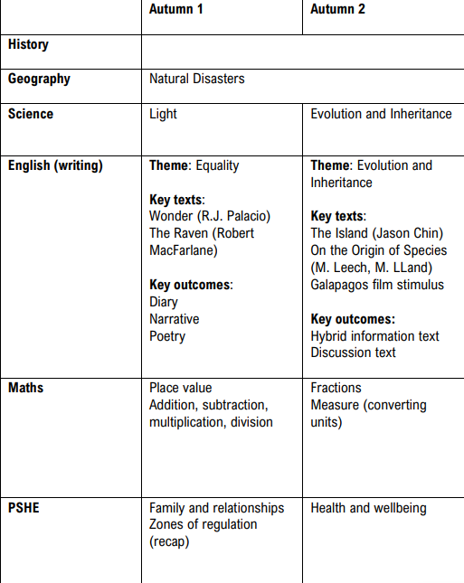
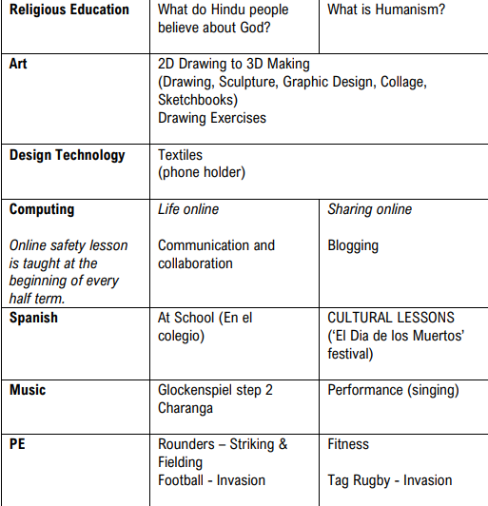

Slide 7
Geography
Natural Disasters – Volcanoes & Earthquakes
To understand the structure of the Earth
To describe the effects of plate movement
To describe and explain the features of a volcano
To locate and research well known volcanic eruptions
To identify the effects of a volcano
To debate positives and negatives of volcanoes
To locate where earthquakes have occurred and identify the effects on land and people inc Tsunami
Identify how to prepare for an earthquake

Slide 8
Science
What light does?
How does light travel?
Light appears to travel in straight lines. We can see a light source because some of the light from the source enters our eyes.
What can we change about a shadow?
Light travelling in straight lines can be used to explain why a shadow is the same shape as the object that casts it and how the shape of shadows can be changed.
What might affect the size of a shadow?
The idea that light travels in straight lines can be used to explain what is observed when testing predictions about shadows.
What affects the size of a shadow?
The shape of a shadow and the pattern to how shadows change size when the relative positions of the light, object and screen are changed, can be explained by light travelling in straight lines.
How is light reflected?
Light is reflected from shiny surfaces in a predictable way because it travels in straight lines.
How do we see objects?
We can see objects because they reflect some of the light that falls onto them into our eyes.

Slide 9
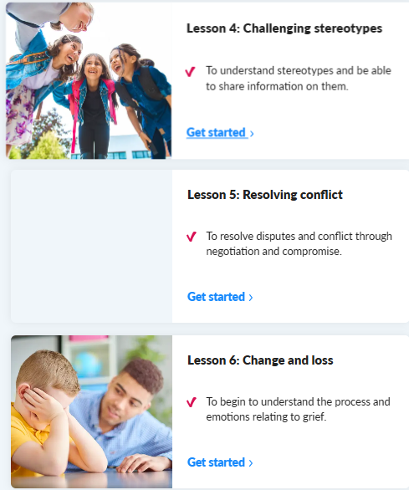
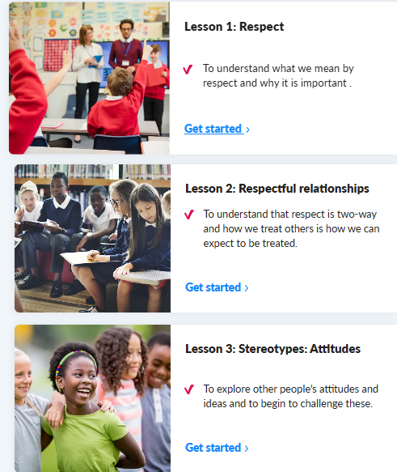
PSHE

Slide 10
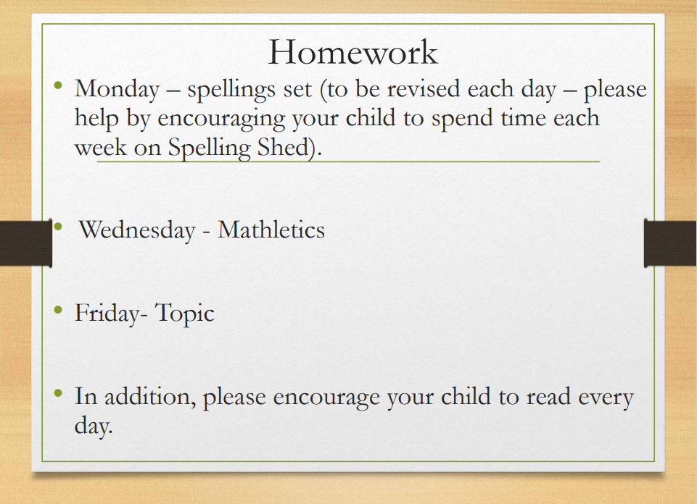


Slide 11
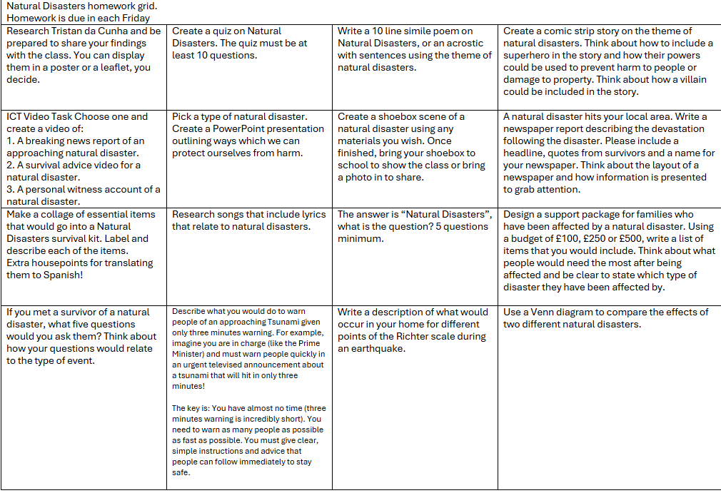

Slide 12
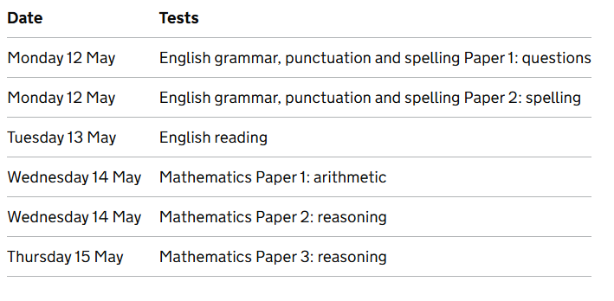

Slide 13
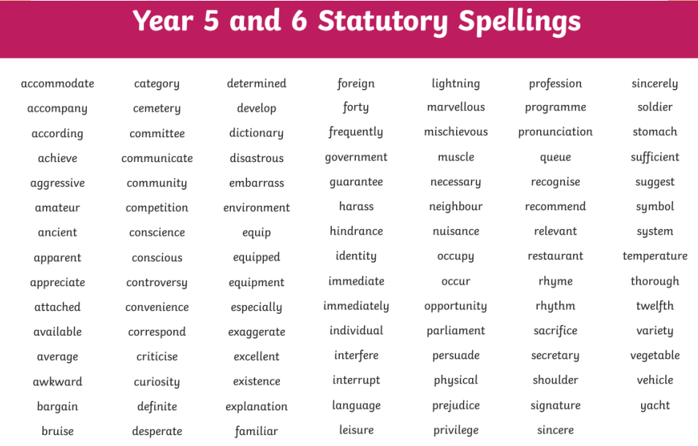
There is allocated time in our timetable to focus on these key spellings

Slide 14
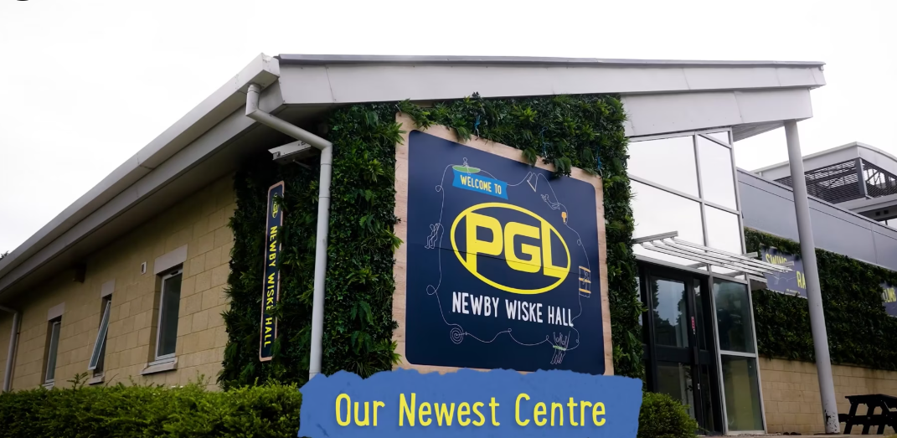
PGL Newby Wiske Hall
Location: Northallerton
Dates: Wednesday 8th October to Friday 10th October (Week 6)
Date of information meeting: Friday 19th September, 2:40pm

Slide 15


